Slide 1
Dynamic Programming
Longest Common Subsequences

Slide 2
Subsequences
Suppose you have a sequence
X = < x₁,x₂,…,x_{m}>
of elements over a finite set S.
A sequence Z = < z₁,z₂,…,z_{k}> over S is called a subsequence of X if and only if it can be obtained from X by deleting elements.

Slide 3
Common Subsequences
Suppose that X and Y are two sequences over a set S.
We say that Z is a common subsequence of X and Y if and only if
Z is a subsequence of X
Z is a subsequence of Y

Slide 4


The Longest Common Subsequence Problem
Given two sequences X and Y over a set S, the longest common subsequence problem asks to find a common subsequence of X and Y that is of maximal length.

Slide 5
Naïve Solution
Let X be a sequence of length m,
and Y a sequence of length n.
Check for every subsequence of X whether it is a subsequence of Y, and return the longest common subsequence found.
There are 2^{m} subsequences of X. Testing a sequences whether or not it is a subsequence of Y takes O(n) time. Thus, the naïve algorithm would take O(n2^{m}) time.

Slide 6
LCS Notation
Let X and Y be sequences.
We denote by LCS(X, Y) the set of longest common subsequences of X and Y.

Slide 7
Optimal Substructure
Let X = < x₁,x₂,…,x_{m}>
and Y = < y₁,y₂,…,y_{n}> be two sequences.
Let Z = < z₁,z₂,…,z_{k}> is any LCS of X and Y.
If x_{m} = y_{n} then certainly x_{m} = y_{n} = z_{k}
and Z_{k-1} is in LCS(X_{m-1} , Y_{n-1})
If x_{m} <> y_{n} then x_{m} <> z_{k} implies that Z is in LCS(X_{m-1} , Y)
If x_{m} <> y_{n} then y_{n} <> z_{k} implies that Z is in LCS(X, Y_{n-1})

Slide 8
Overlapping Subproblems
If x_{m} = y_{n} then we solve the subproblem to find an element in LCS(X_{m-1} , Y_{n-1} ) and append x_{m}
If x_{m} <> y_{n} then we solve the two subproblems of finding elements in LCS(X_{m-1} , Y ) and LCS(X , Y_{n-1} ) and choose the longer one.

Slide 9
Recursive Solution
Let X and Y be sequences.
Let c[i,j] be the length of an element in LCS(X_{i}, Y_{j}).
c[i,j] =
0
if i=0 or j=0
c[i-1,j-1]+1
if i,j>0 and x_{i} = y_{j}
max(c[i-1,j],c[i,j-1])
if i,j>0 and x_{i} <> y_{j}

Slide 10
Example
Start at b[m,n]. Follow the arrows. Each diagonal array gives one element of the LCS.

Slide 11
LCS(X,Y)
m ← length[X]
n ← length[Y]
for i ← 1 to m do c[i,0] ← 0
for j ← 1 to n do c[0,j] ← 0

Slide 12
LCS(X,Y)
for i ← 1 to m do for j ← 1 to n do if x_{i} = y_{j} c[i, j] ← c[i-1, j-1]+1 b[i, j] ← “ ”
else
if c[i-1, j] ≥ c[i, j-1] c[i, j] ← c[i-1, j] b[i, j] ← “ ” else c[i, j] ← c[i, j-1] b[i, j] ← “ ”
return c and b

Slide 13
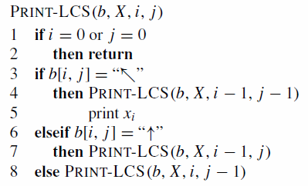
Constructing an LCS

Slide 14
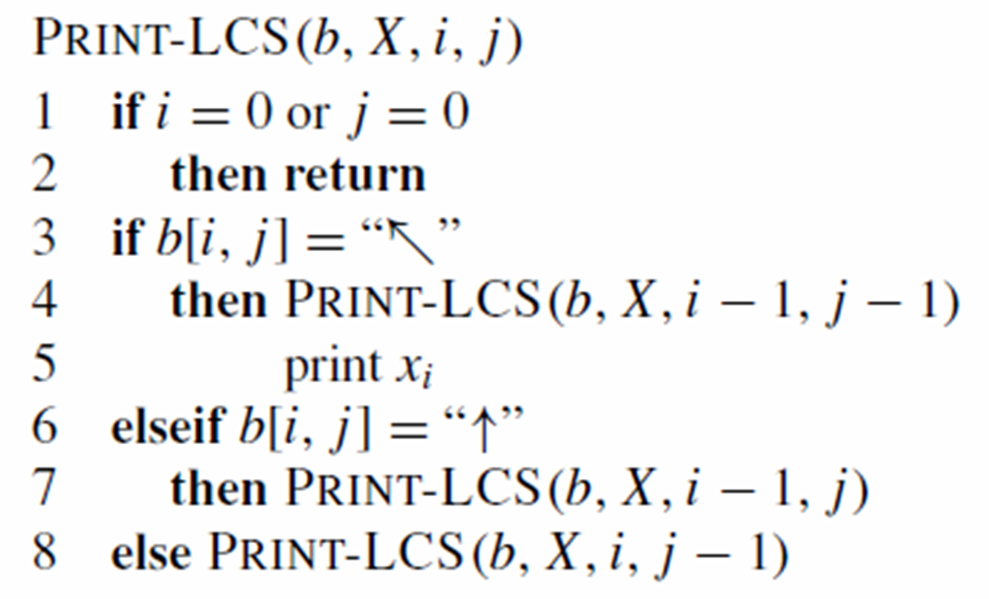
Y : s e c r e t
X :b i s e c t
6,6
Print x6 or y6
5,5
5,4
5,3
Print x5 or y3
4,2
Print x4 or y2
3,1
Print x3 or y1
2,0

Slide 15
Problem
X : s t o n e
Y : l o n g e s t
Find the Longest Common Subsequence

Slide 16


